Slide 1
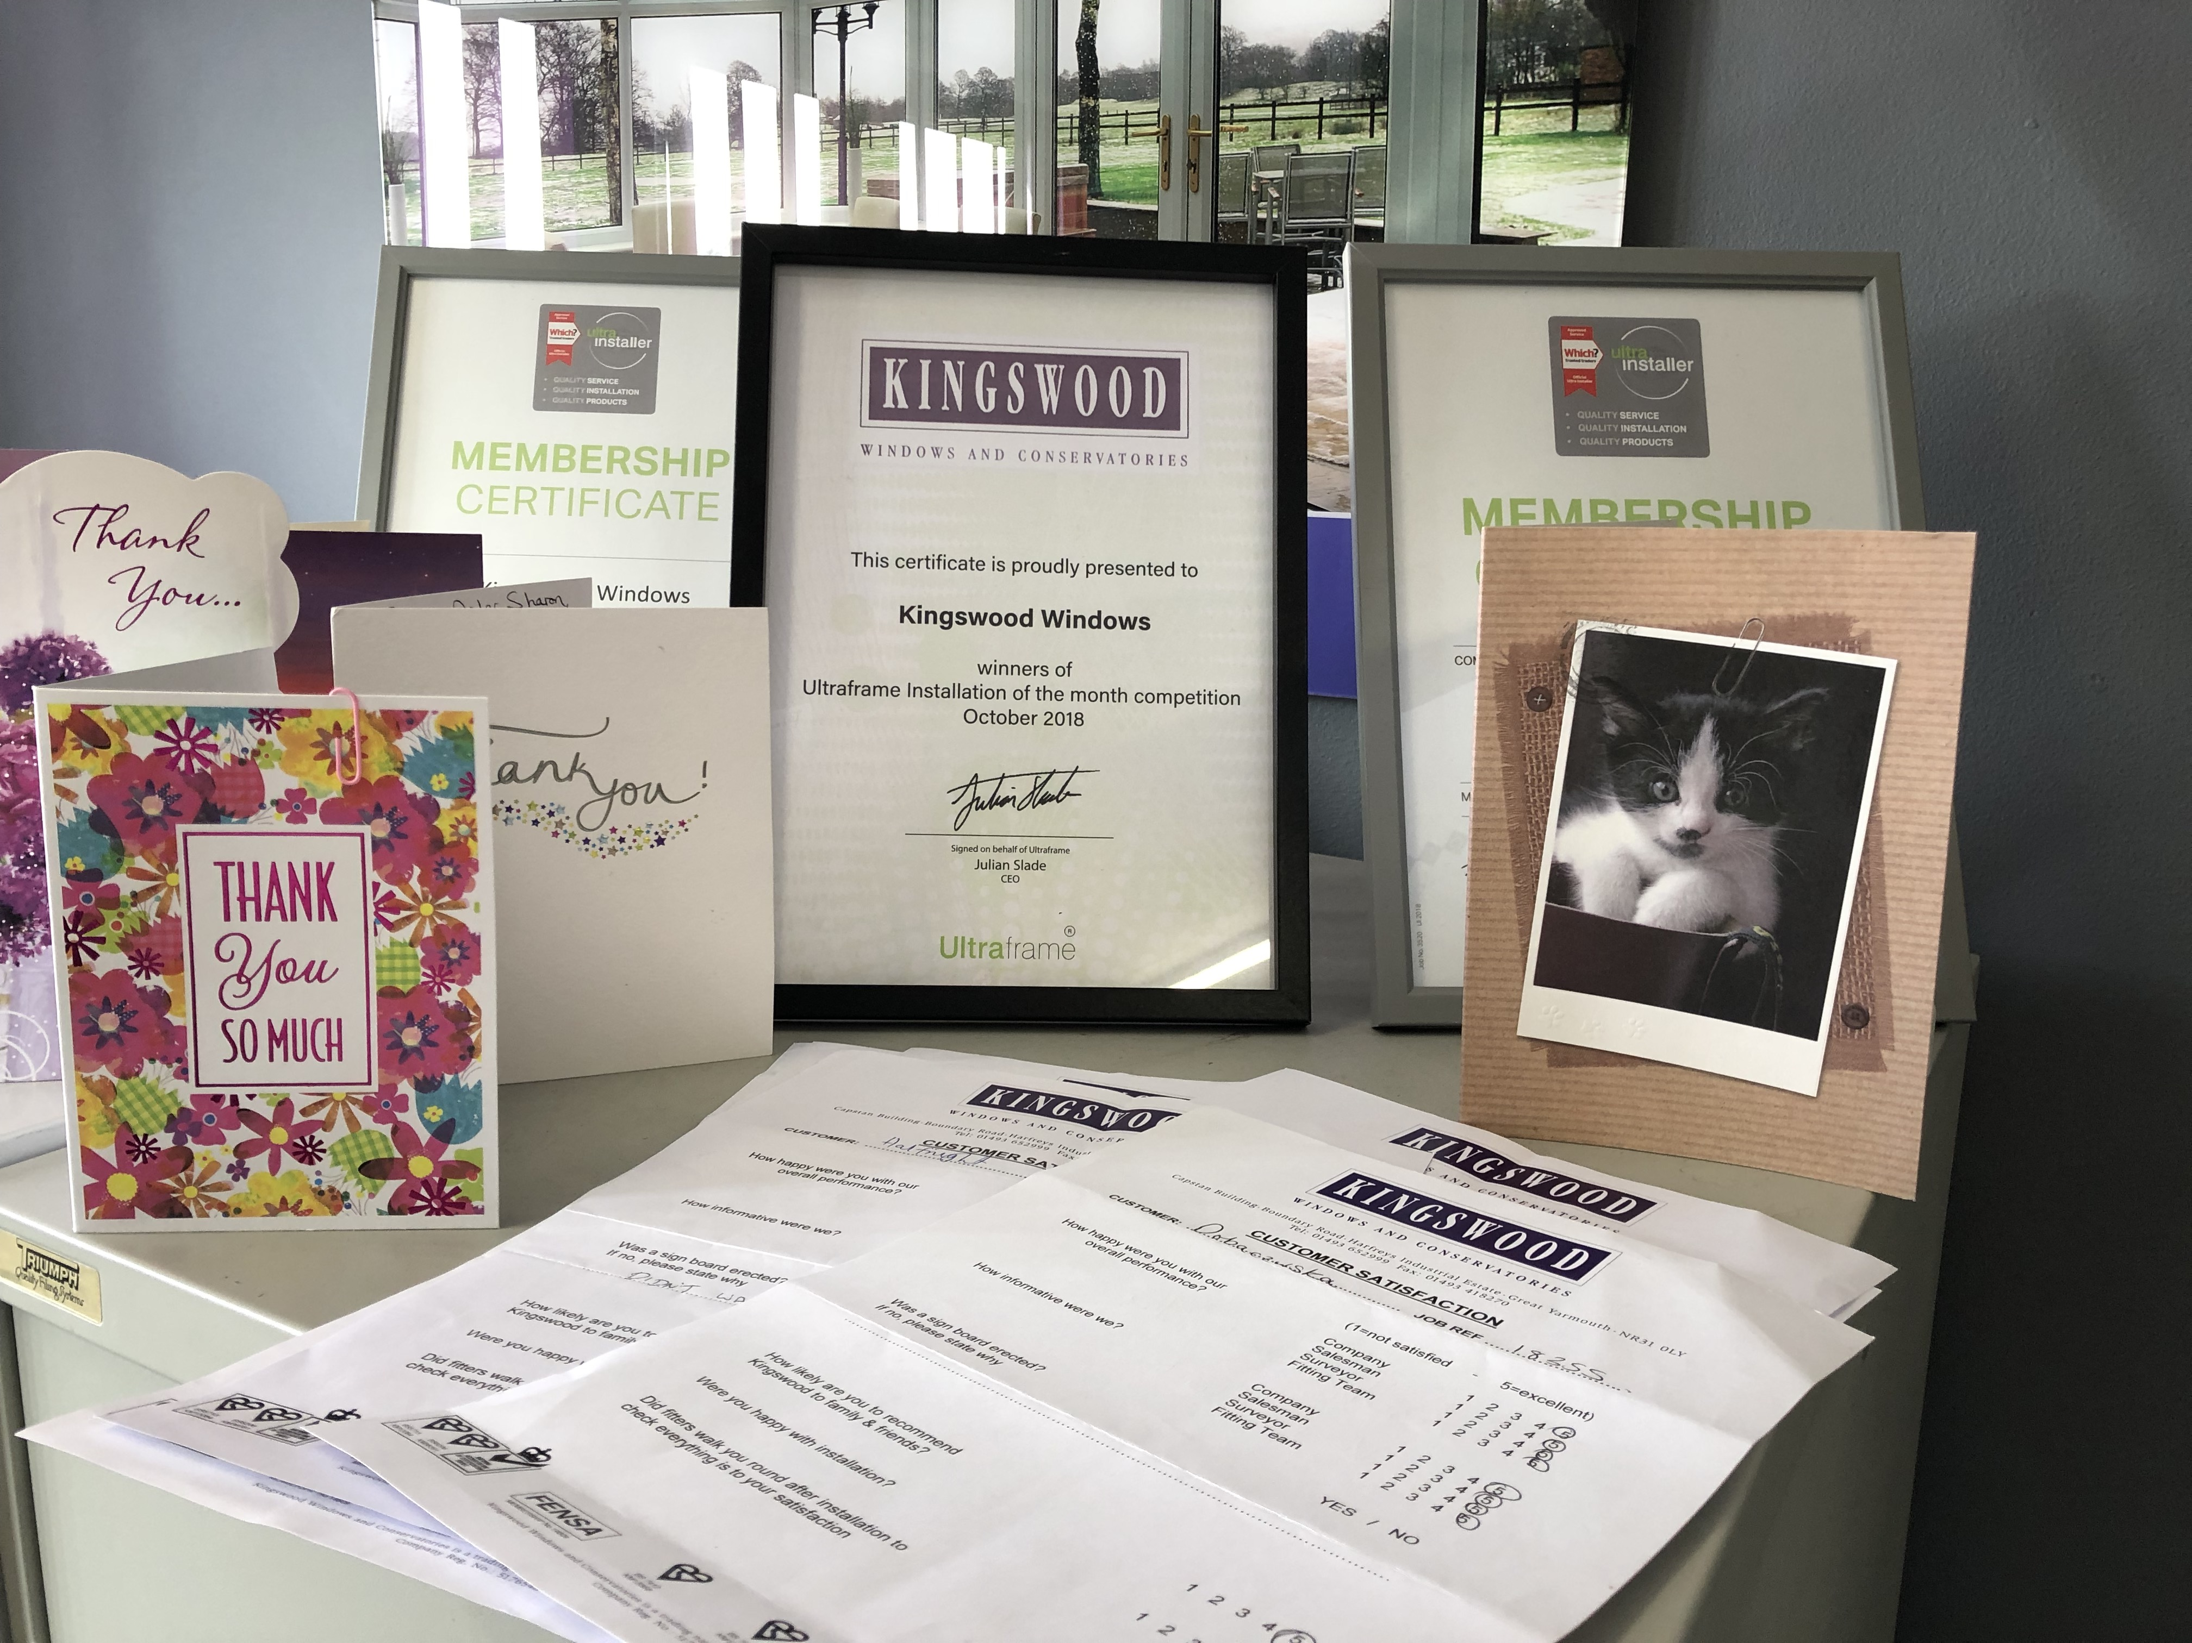
25%
this Autumn
Family Business Established 23years
No Commission Salesmen
Family Business Established 23years
No Commission Salesmen

